Slide 1


Crypto vs
the Market
Dan McQueen
Jason Buckholt
Majid Kouki
Tracy Emory

Slide 2
Project Description
Bitcoin investing vs S&P 500
Does BTC beat the market holding long-term?
How do the results differ when a basic swing trading strategy is implemented?

Slide 3
Libraries
Pandas
Pandas TA
Voila
Alpaca Trade API
PyViz
dotenv
MCForecastTools

Slide 4
Datasets
SPY - Alpaca
BTC - Coinbase Exchange
Exchange data other than Coinbase was removed
Cumulative returns Calculated for Monte Carlo Simulations

Slide 5
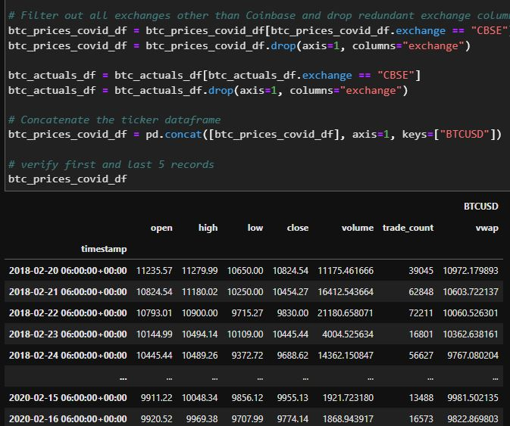
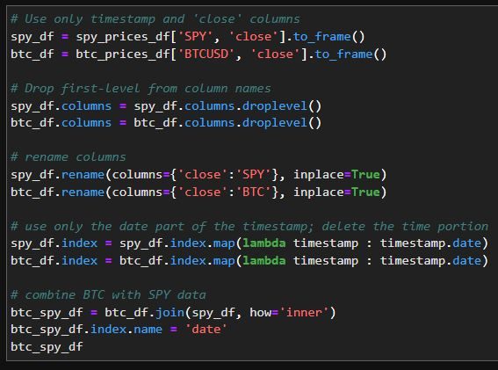
BTC vs SPY
Collecting Data

Slide 6
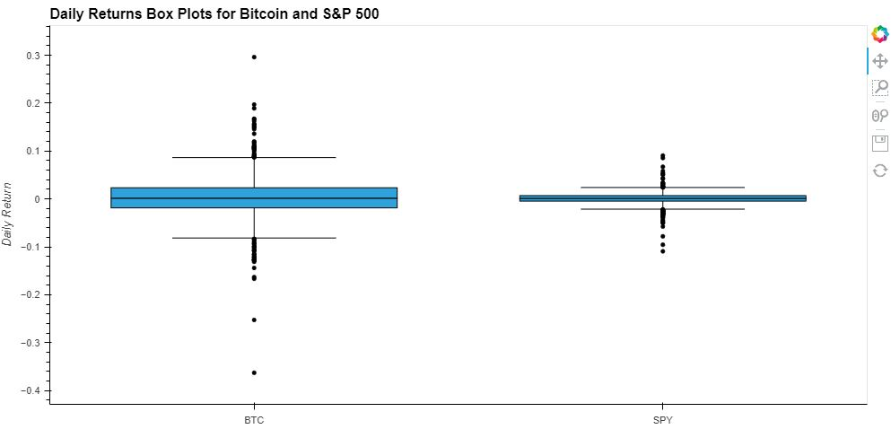
BTC vs SPY
Holding Long-Term
SPY BTC
Volatility
0.219753 0.751422
Sharp Ratio
0.484030 0.739624

Slide 7
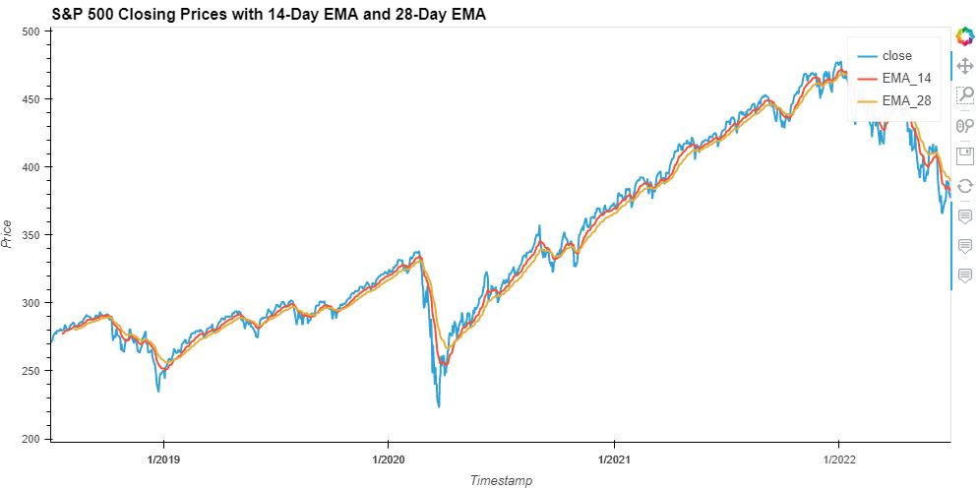
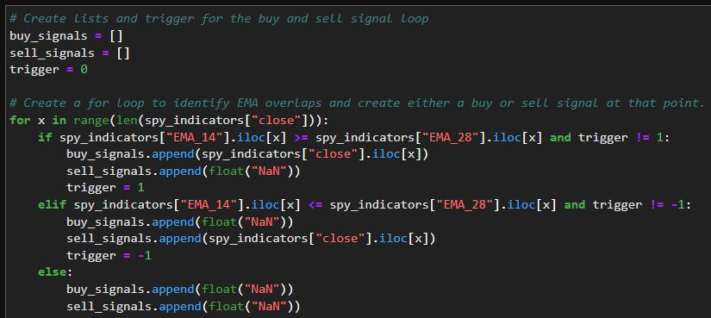
BTC vs SPY
Swing Trading

Slide 8
BTC vs SPY
Swing Trading

Slide 9
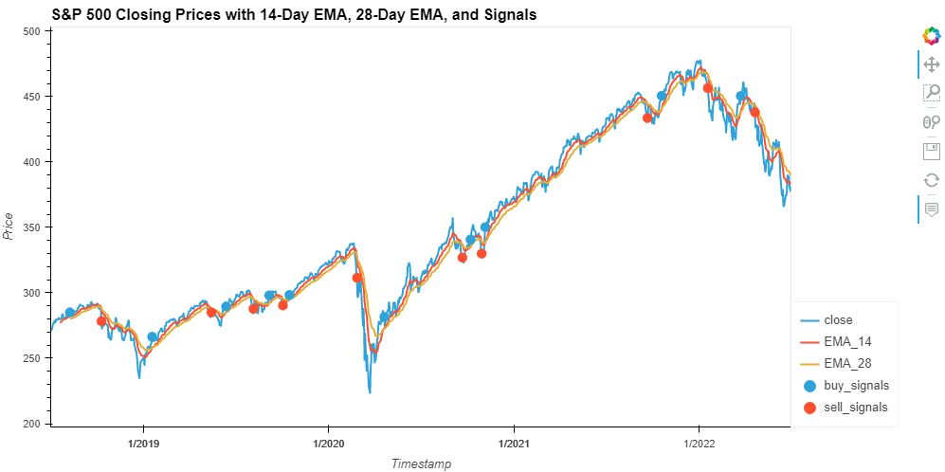
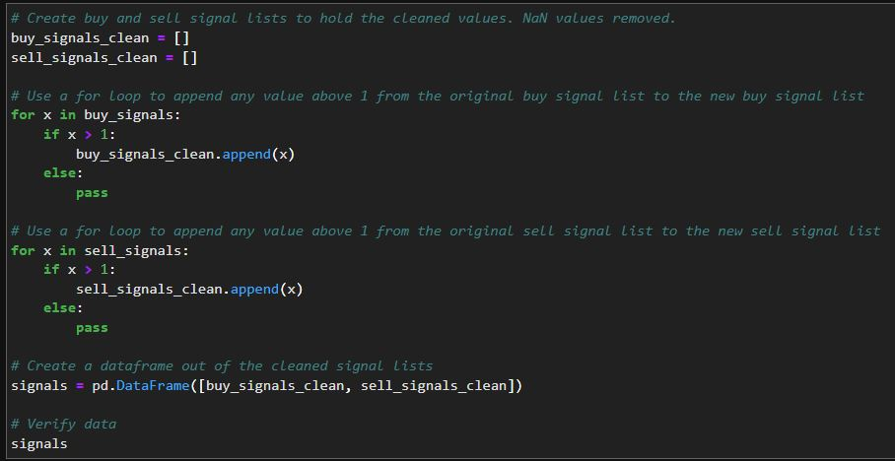
BTC vs SPY
Swing Trading

Slide 10
BTC vs SPY
Swing Trading

Slide 11
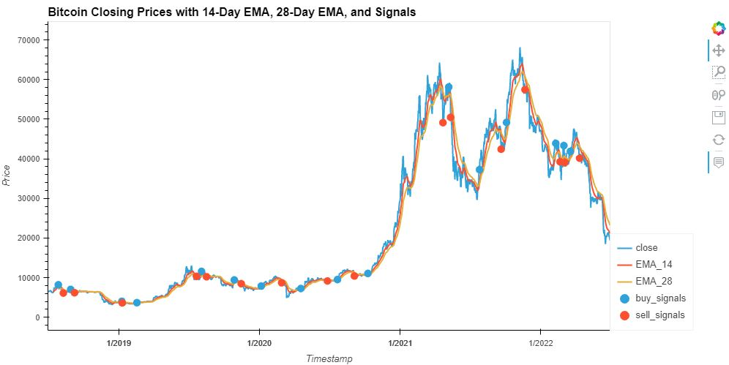
BTC vs SPY
Swing Trading
Long-Term Holding ​
​
$13067.58 in profits per coin​
​
14-Day & 28-Day EMA Trading Strategy​
​
$37795.01 in profits per coin​
​
Trading resulted in 189.23% more profits over long-term holding
Long-Term Holding
$109.38 in profits per share
14-Day & 28-Day EMA Trading Strategy
$126.94 in profits per share
Trading resulted in 16.05% more profits over long-term holding

Slide 12
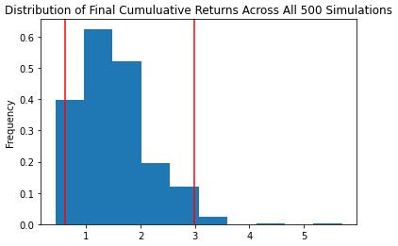
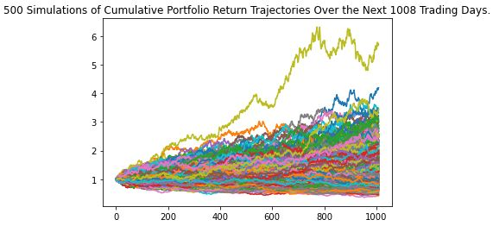
Monte Carlo Simulation
4 Years
500 Simulations
SPY

Slide 13
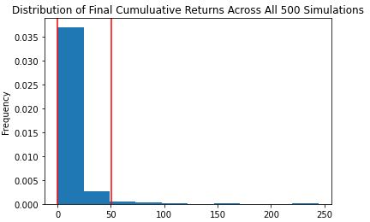
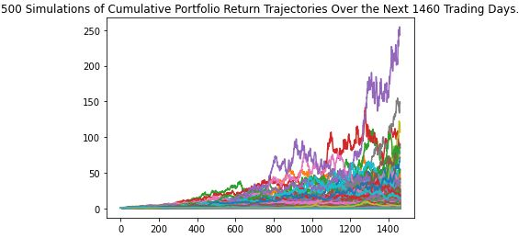
Monte Carlo Simulation
4 Years
500 Simulations
BTC

Slide 14
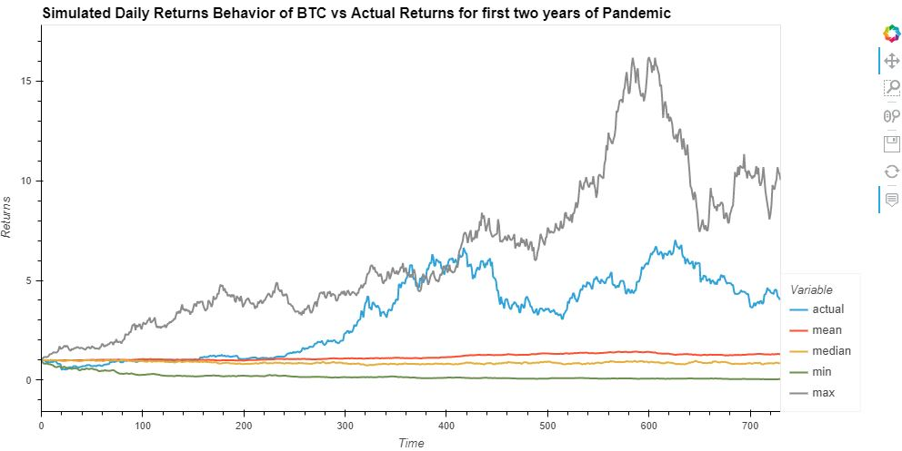
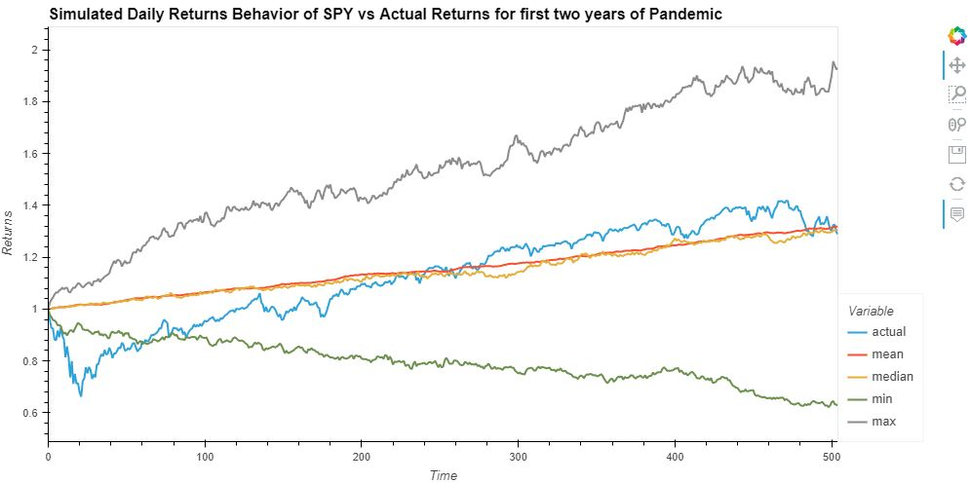
Monte Carlo Simulation
Pandemic Results

Slide 15
01
BTC beats the market in both long term hold and swing trading
Closing Notes
02
Swing trading proved more profitable when using EMA trading strategy
03
Monte Carlo simulation proved inaccurate for BTC

Slide 16
01
Command Line Interface
Project Expansion
02
Additional Indexes, Stocks, and Crypto Currency
03
Problems with Monte Carlo Simulations

Slide 17
Crypto vs
the Market
Dan McQueen
Jason Buckholt
Majid Kouki
Tracy Emory

